Slide 1

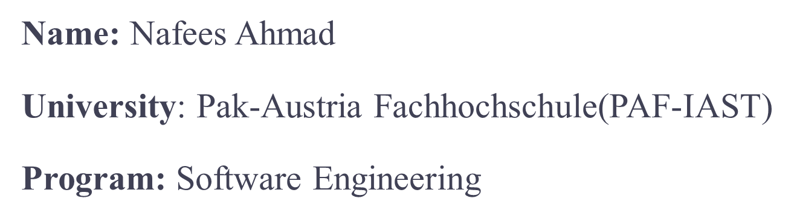
SmartDoc Extractor: Named-Entity Recognition
Space link: https://huggingface.co/spaces/nafees369/NER

Slide 2
Problem Statement
Extracting information from documents can be tedious and time-consuming. Manually identifying key entities, such as names, locations, and organizations, is a laborious task. Our goal is to develop an automated solution to streamline this process.
Efficiency
Accuracy
Reduce manual effort and save time.
Minimize errors and ensure reliable information extraction.
Scalability
Handle large volumes of documents and adapt to evolving needs.

Slide 3

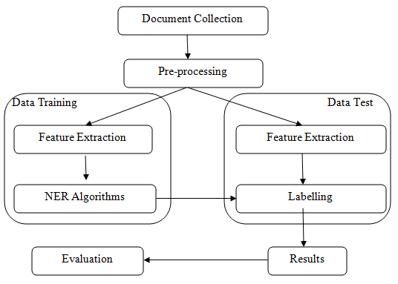



Approach and Architecture
Our approach leverages the power of deep learning and Hugging Face's Transformers library. We employ a state-of-the-art Named-Entity Recognition (NER) model to identify and classify entities within text.
Preprocessing
Clean and format the input document, tokenizing and converting the text into a format suitable for the model.
Model Training
Train a BERT-based NER model using a labeled dataset of documents and their corresponding entities.
Entity Recognition
Apply the trained model to new documents to predict and extract entities.
Credit to: ResearchGate
Post-processing
Refine the extracted entities and present them in a structured format.

Slide 4
Key Challenges
Building a robust and accurate NER system presents several challenges.
1
Data Quality
Maintaining accurate and consistent labeling of training data is crucial.
2
Model Complexity
Balancing model complexity and computational resources is essential.
3
Entity Ambiguity
Handling entities with multiple meanings or overlapping categories.

Slide 5
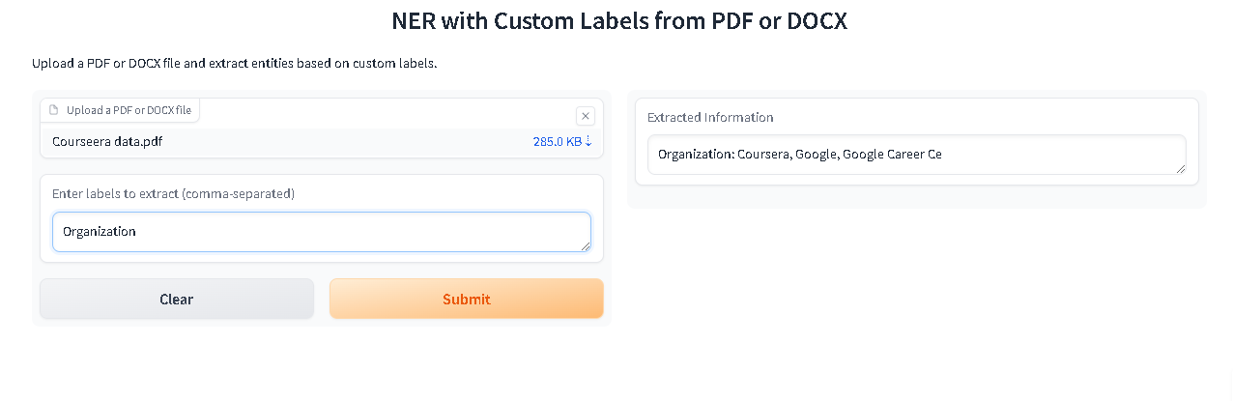
Conclusion
Benefits | Automated Entity Extraction
Impact | Improved Efficiency and Accuracy
Future | Continued Development and refinement

